Slide 1
Better Together: Text + Context Final Presentation
Kenneth Church
Aug 3, 2023
https://github.com/kwchurch/JSALT_Better_Together

Slide 2
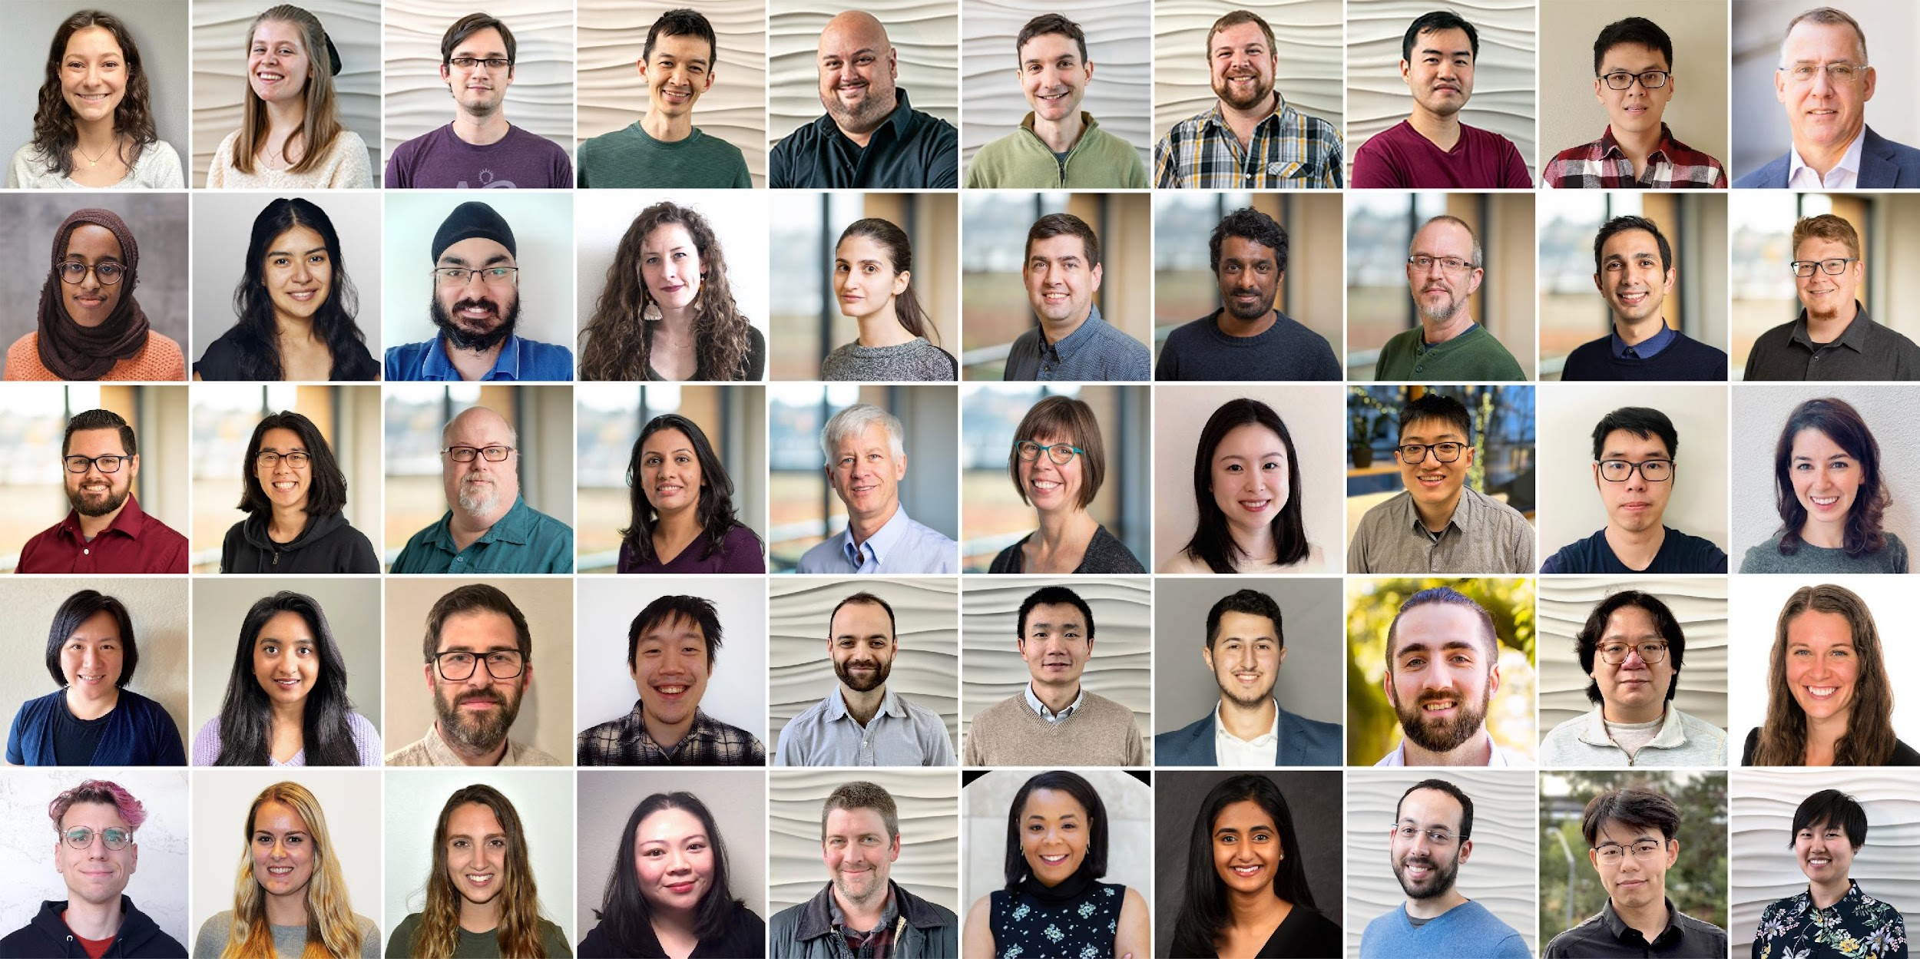
Semantic Scholar (S2): Significant Effort (slide from Dan Weld)
50 person team
7 year project
207M+ scientific paper index
8M+ monthly active users

Slide 3
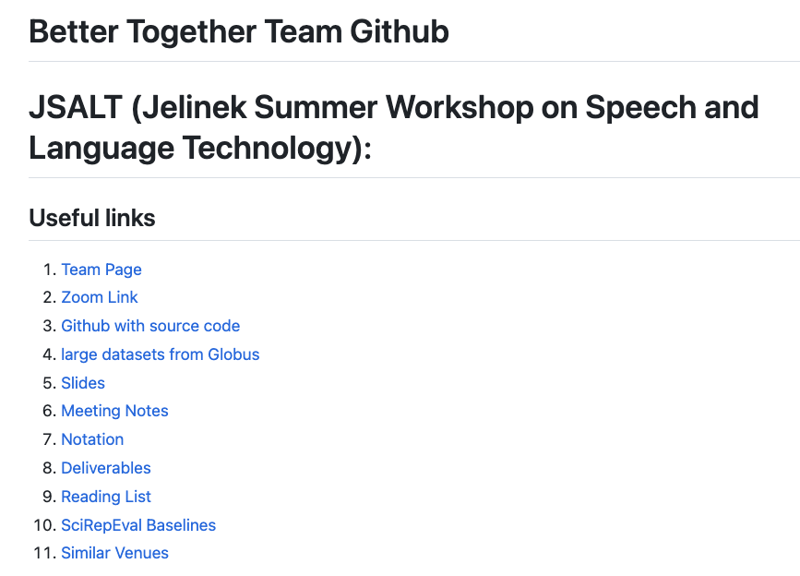
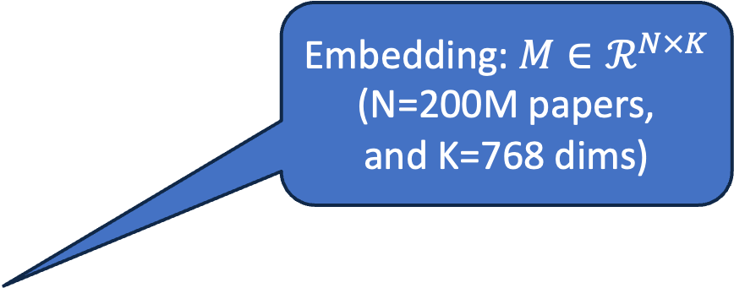
https://github.com/kwchurch/JSALT_Better_Together
Embedding: $M∈ℛ^{N×K}$
(N=200M papers,
and K=768 dims)
including these slides

Slide 4

Better Together: Text (Titles, Abstracts, Body); Context (Citations)

Slide 5
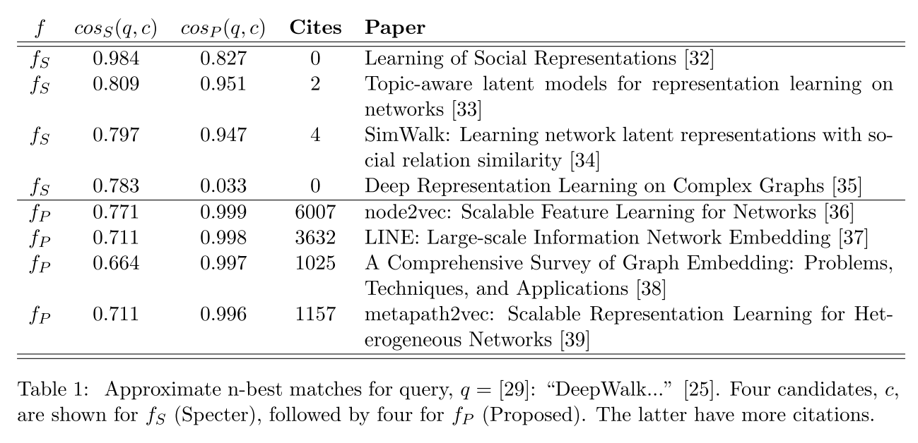
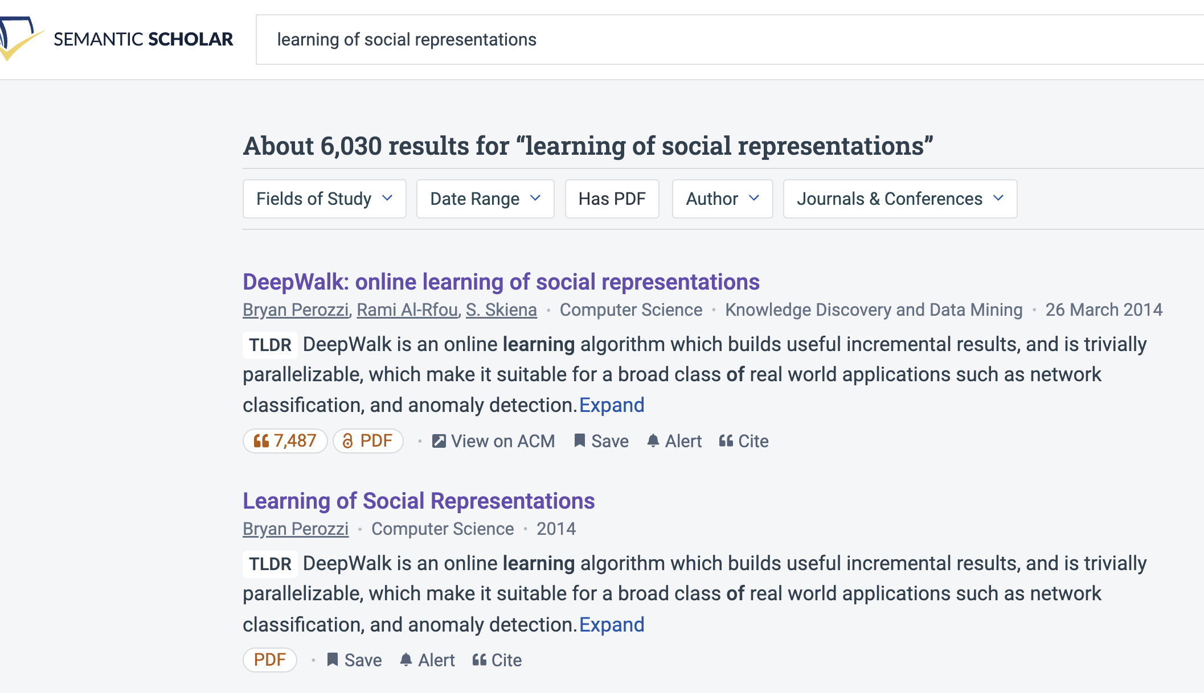
Query: ``DeepWalk: Online Learning of…’’

Slide 6
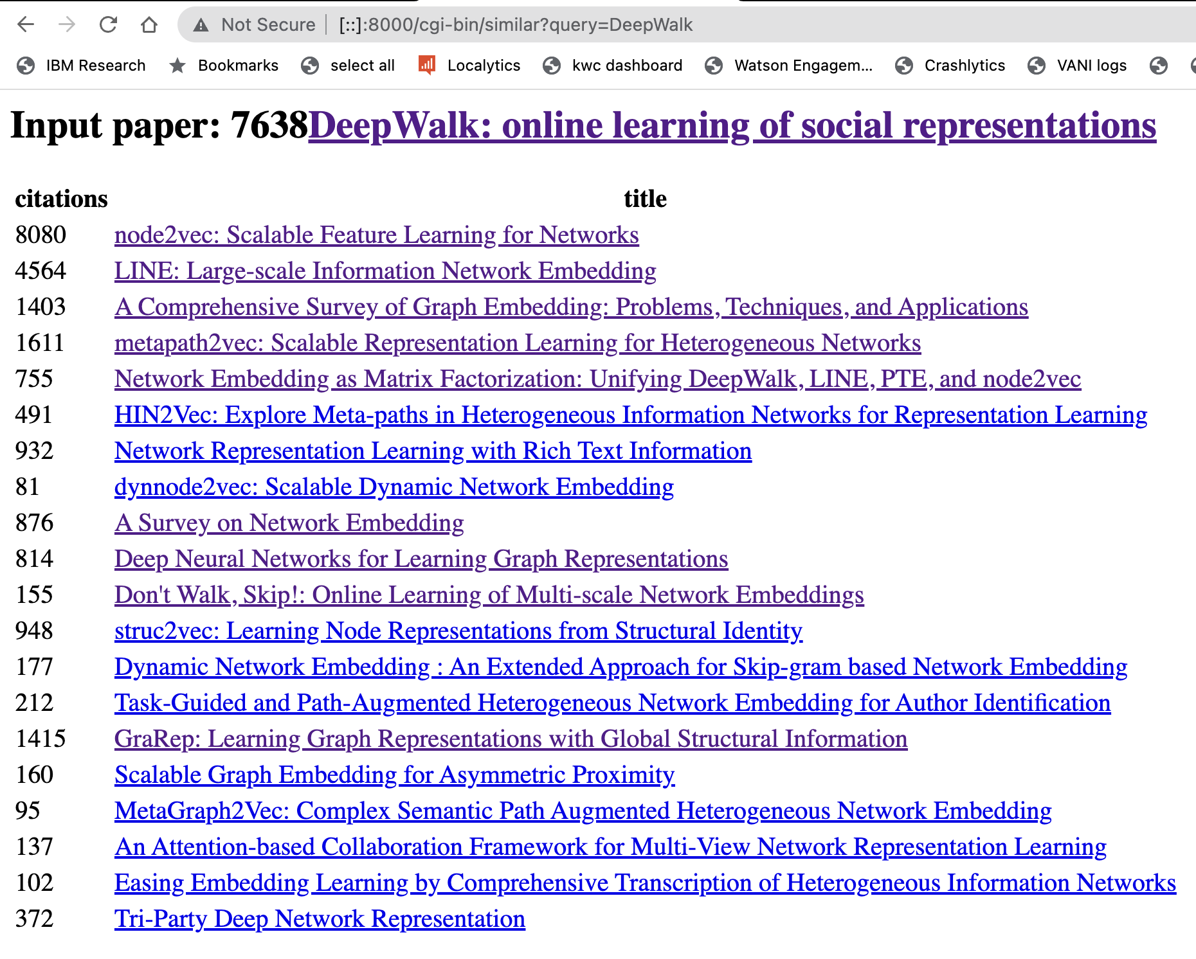
Web Server

Slide 7
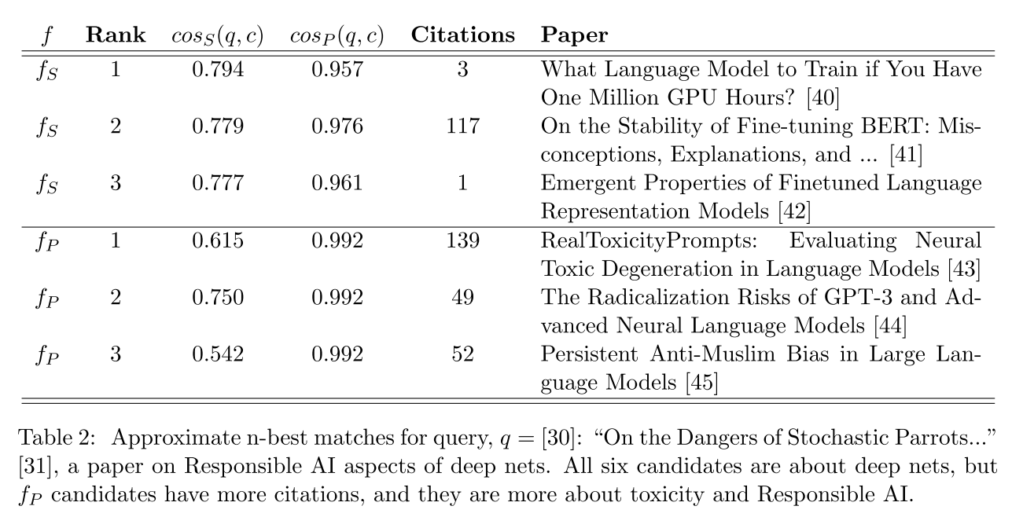
Query: ``On the Dangers of Stochastic Parrots…’’

Slide 8
Deliverables
GitHub:
too much, rough notes, slides
work in progress
Web Server
Recommendations
Input: queries for documents
Output: recommendations (docs)
What Should I read? Cite?
doc2vec
Input: corpusId
Output: vectors (from specter1, specter2, scincl, proposed)
doc2refs
Input: corpusId
Output: refs (corpusIds)
Resources
Bulk access to data files behind web server:
citation graph,
embeddings,
indexes for approx. nearest neighbors
pairs of corpusIds with large cosines
Evaluations & Benchmarks
Split of 200M corpusIds into 100 bins
2M corpusIds per bin
bins associated with time
oldest 2M papers are in bin 000
newest 2M papers are in bin 099
Intrinsic and Extrinsic evaluations
Perplexity, Random Walks, Link Prediction

Slide 9
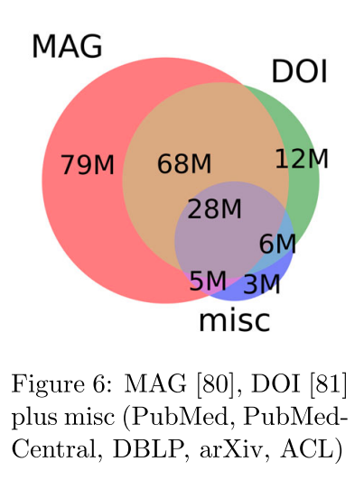
Semantic Scholar (S2)
Seven Sources
Fields of Study
Medicine (45M) | Engineering (8M) | Business (4M) | Geology (3M)
Chemistry (13M) | Physics (7M) | Sociology (3M) | History (2M)
Computer Science (13M) | Psychology (7M) | Geography (3M) | Art (2M)
Biology (13M) | Mathematics (5M) | Economics (3M) | Philosophy (1M)
Materials Science (10M) | Political Science (4M) | Environmental Science (3M)

Slide 10
Opportunities
Encourage practical solutions to real problems
Recommendations: What should I read? Cite?
Too many benchmarks are unrealistic (small, clean)
Realities
Literature is large and growing (doubles every 9 years)
Dirty Data (Values are missing and incorrect)
Scale
How do space, time and loss scale with size of citation graph?

Slide 11
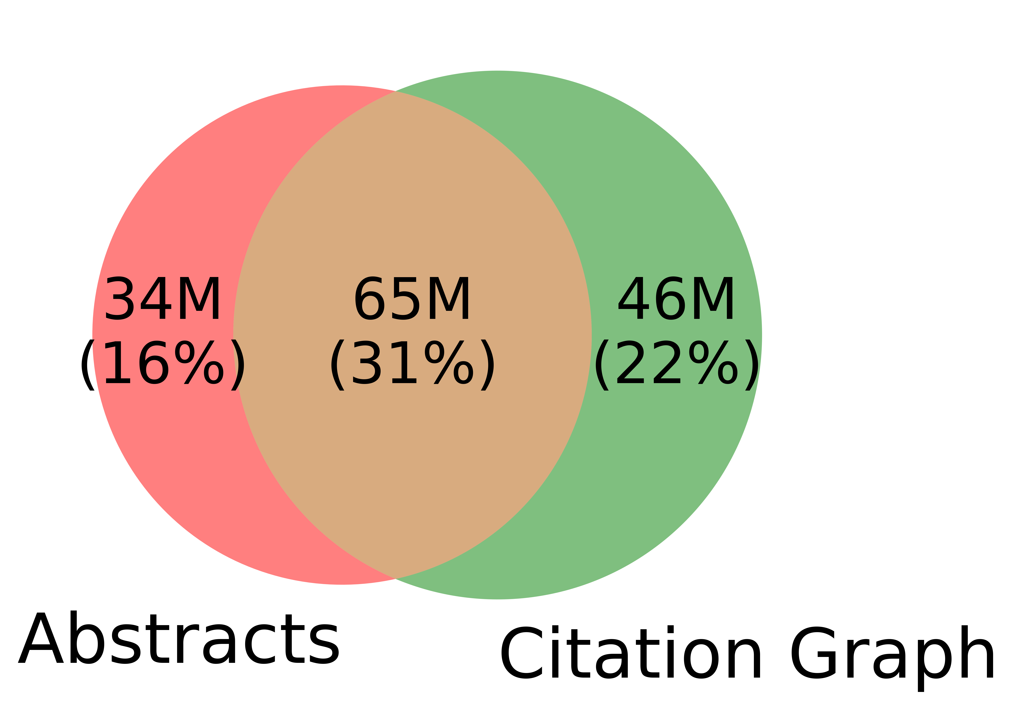
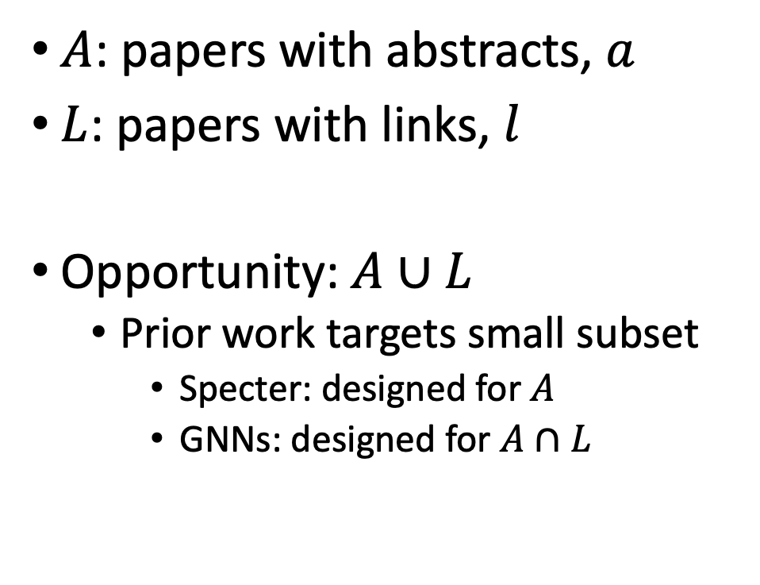
Realities: Missing Values
$A$: papers with abstracts, $a$
$L$: papers with links, $l$
Opportunity:$A∪L$
Prior work targets small subset
Specter: designed for $A$
GNNs: designed for $A∩L$
Other
(31%)

Slide 12
Realities
The Real World
Idealizations (Evaluation Benchmarks)
Large (Metcalfe’s Law)
Growing
Dirty
Missing Values
Bad/misleading Values
Small
Static
Clean

Slide 13
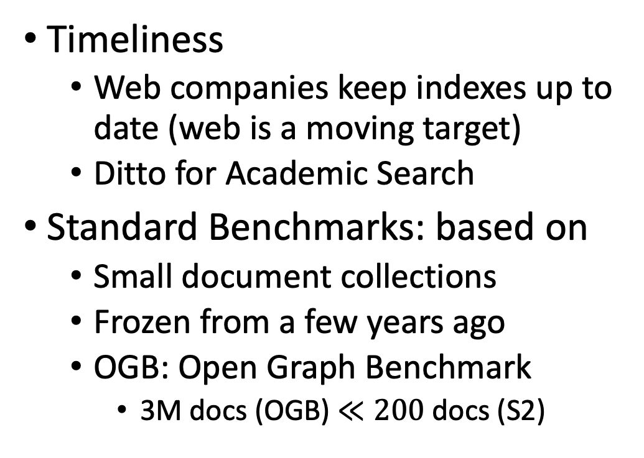
Global Scientific Output Doubles Every 9 Years
Timeliness
Web companies keep indexes up to date (web is a moving target)
Ditto for Academic Search
Standard Benchmarks: based on
Small document collections
Frozen from a few years ago
OGB: Open Graph Benchmark
3M docs (OGB) $≪200$ docs (S2)

Slide 14
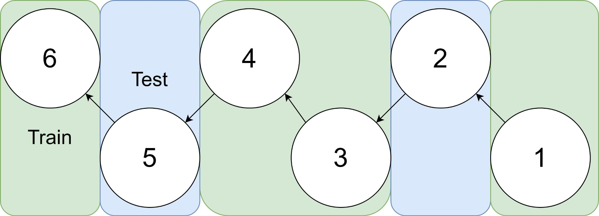
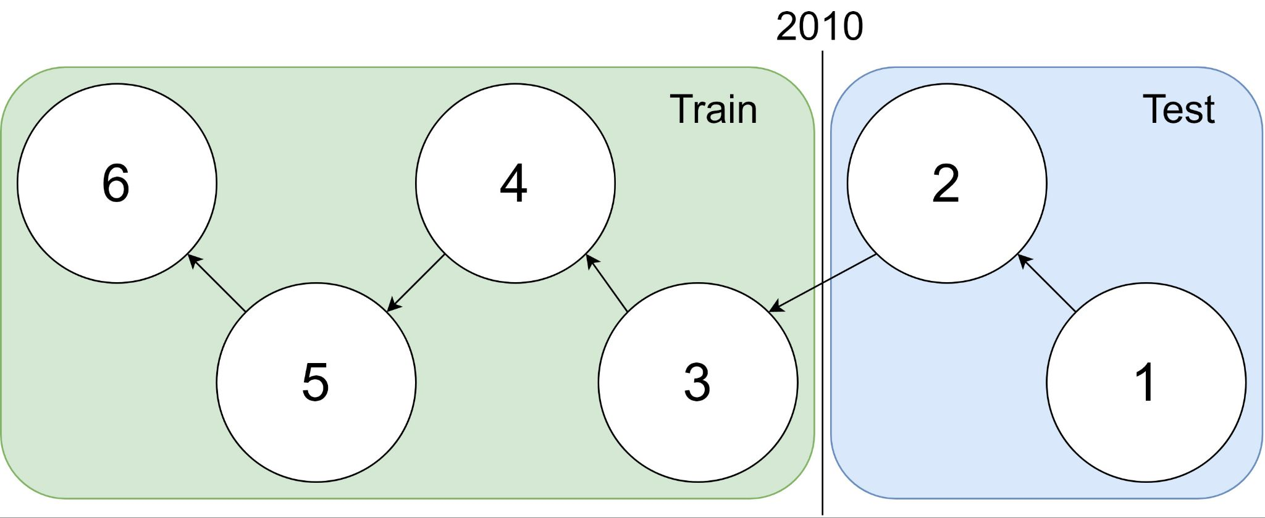
Example: 1 cites 2, 2 cites 3, … 5 cites 6
Traditional Train-Test Split (Non-Causal)
idx | Pub Year | Paper Title
1 | 2018 | [...] Photofragment imaging
2 | 2016 | Convenient probe of S(1D2)[...]
3 | 2005 | Megapixel ion imaging [...]
4 | 2003 | Direct current slice imaging [...]
5 | 1995 | profiles of Cl(2Pj) photofragments [...]
6 | 1988 | Adiabatic dissociation of [...]
Proposed Train-Test Splits (Causal)
Notes:
No asymmetry of time - how to reduce to a soundbite
Audience soundbites
‘Almost all studies in ml do test-train split’ that’s a bad idea when you have time

Slide 15
Standard Benchmarks (e.g., OGB, SciRepEval) are Small, Static & Clean
OGB (Open Graph Benchmark)
S2 (Semantic Scholar)
Nodes (papers): 3M
Static
(Frozen for KDD-2021 CUP)
Train: before 20??
Test: 20??
Nearly all papers have both
Vectors (from word2vec)
Links (from citation graph)
Nodes (papers): 200+ M
Dynamic
Doubles every 9 years
Many papers with missing values
Many missing vectors
(based on abstracts)
Many missing links

Slide 16
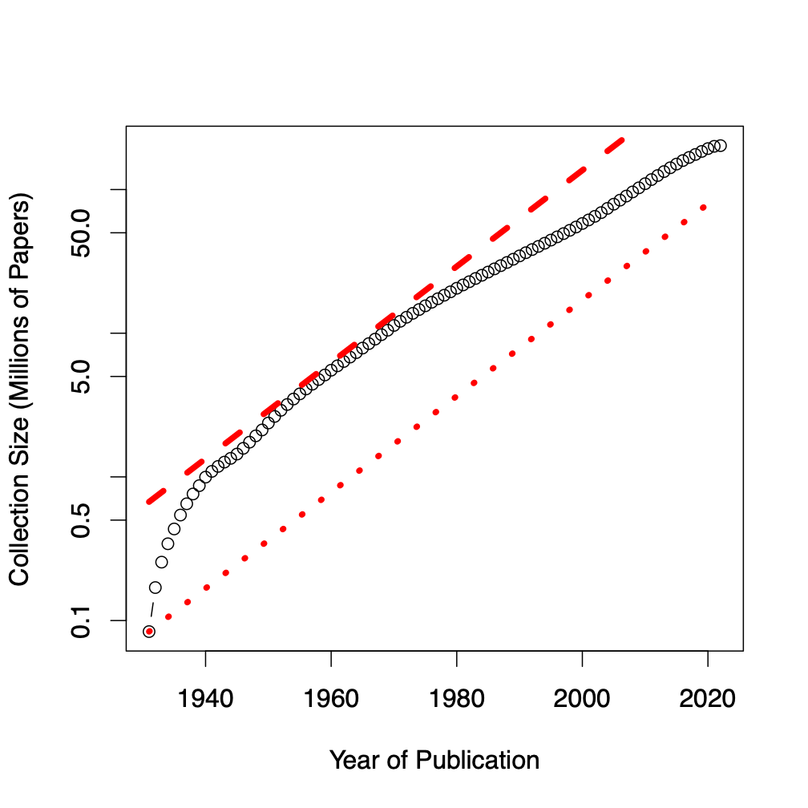
Benchmarks
Dataset | #N | #E | Node Raw Features
ogbl-citation2 | 3M | 31M | 128 (eg. word2vec)
Semantic scholar | 200M | 2B | 768 (eg. Bert)
Notes:
Graph showing growth

Slide 17
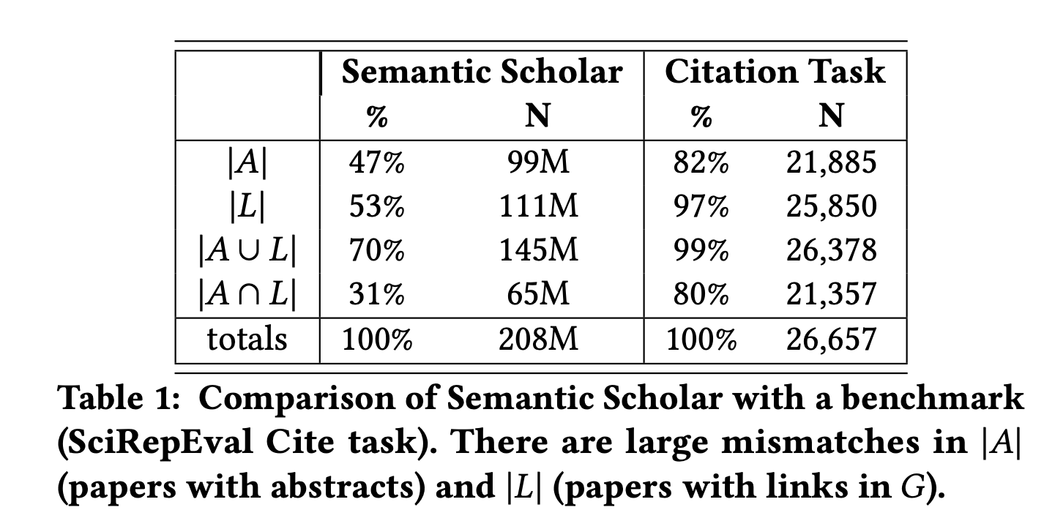
Standard Benchmarks are Small, Static & Clean
S2 (Semantic Scholar)
SciRepEval: Fewer Missing Values

Slide 18
Spoiler Alert: Better-Together Conjectures
Multiple representations are helpful
for missing values
If abstracts are missing, use links
If links are missing, use abstracts
and for graphs of different sizes
When graphs are small:
Text >> Links
when graphs are large:
Links >> Text (Metcalfe’s Law)

Slide 19
Proposal: Bins
Research Questions:
How do losses scale
with size of citation graph?
How do losses scale with time?
Weather forecasting:
Short-term is easier than long-term

Slide 20
Resources & Evaluations: How do losses scale with size of citation graph?
We will distribute
Bins: CorpusIds
Graphs & Embeddings for bins
with indexes for ANN
Benchmarks for Experiments
Intrinsic
Perplexity
Random Walk
Year Prediction
Related-Work Hypothesis
Extrinsic
Link Prediction
Experimental Results
Perplexity Experiments
Abteen
Random Walk Experiments
Peter, Ken
Link Prediction Experiments
Peter
Year Prediction
Melissa, Shabnam
Related-Work Hypothesis
Rodolfo, John

Slide 21
How do time and space scale with size of graph?
Embeddings
Standard Embeddings
Specter, SciNCL, LinkBERT
Proposed embedding (ProNE)
Ben, Ken

Slide 22
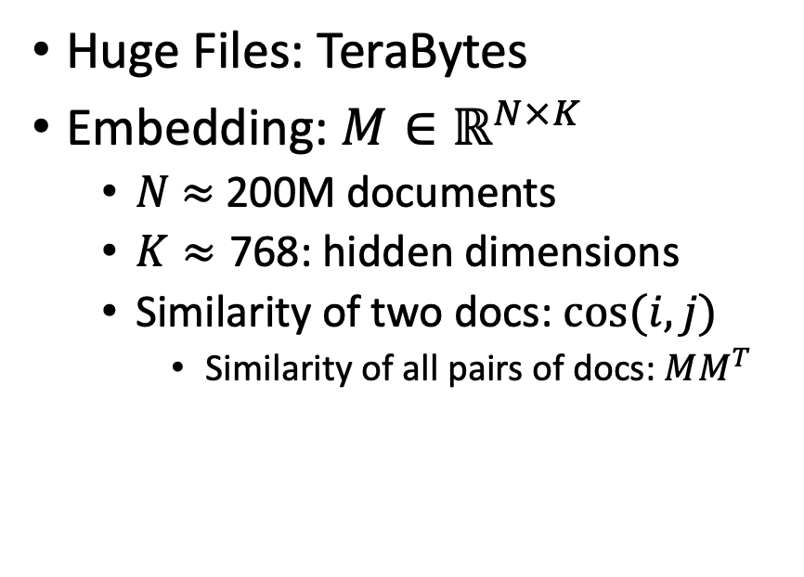
Scale: Both a Blessing and a Curse
Curse
Blessing
Huge Files: TeraBytes
Embedding: $M∈ℝ^{N×K}$
$N$ $≈$ 200M documents
$K≈\text{768}$: hidden dimensions
Similarity of two docs: $cos(i,j)⁡$
Similarity of all pairs of docs: $MM^{T}$
Web search >> Enterprise
Easier to find stuff in large graphs
than small graphs (enterprise)
Approximate Nearest Neighbors
Works better in larger graphs
Network Effects (Metcalfe’s Law)
Rich get richer

Slide 23


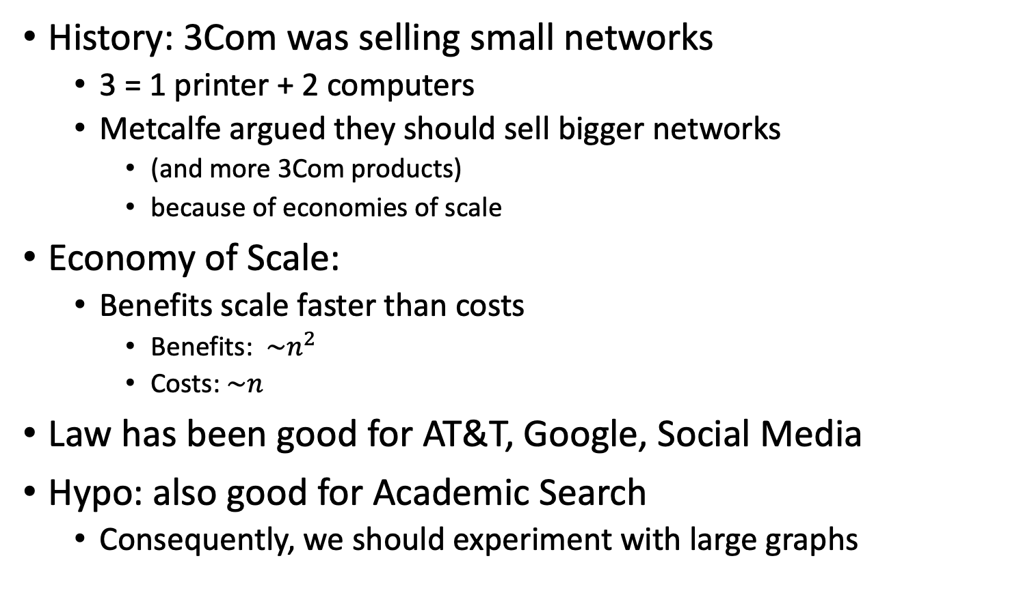
Metcalfe’s Law (Network Effects)
History: 3Com was selling small networks
3 = 1 printer + 2 computers
Metcalfe argued they should sell bigger networks
(and more 3Com products)
because of economies of scale
Economy of Scale:
Benefits scale faster than costs
Benefits: $\sim n^{2}$
Costs:$\sim n$
Law has been good for AT&T, Google, Social Media
Hypo: also good for Academic Search
Consequently, we should experiment with large graphs

Slide 24
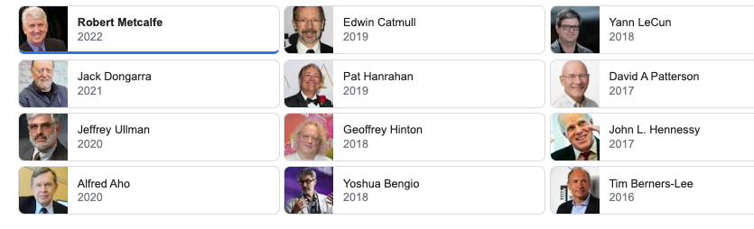
Turing Award/Winners

Slide 25
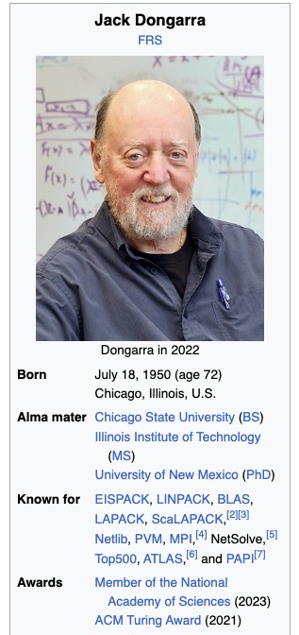
Turing Awards: Metcalfe’s Law, Deep Nets, Linear Algebra
Metclalfe’s Law: Metcalfe
Deep Nets: Hinton, Bengio, LeCun
Linear Algebra: Dongarra

Slide 26
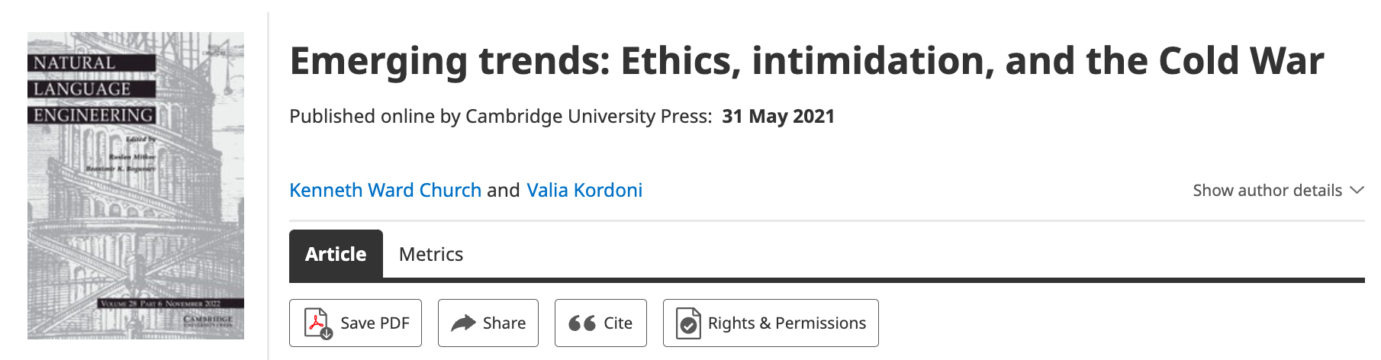
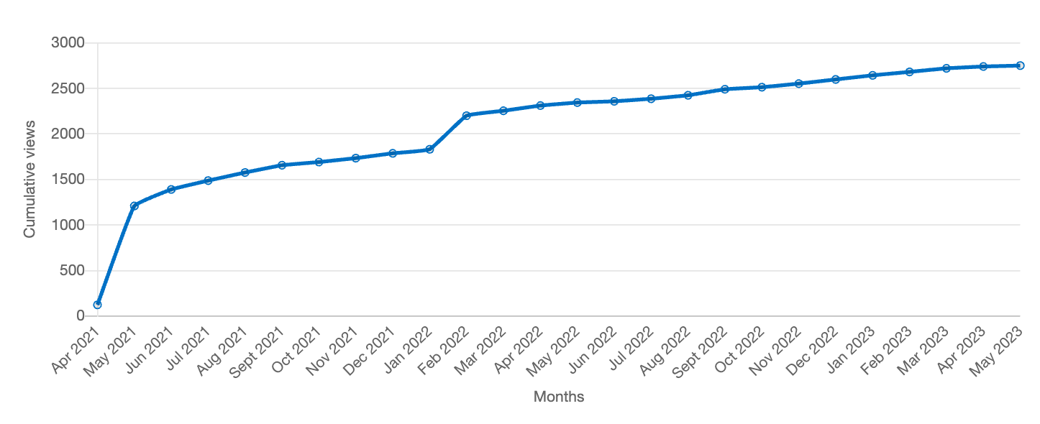
Value: Author Contributions + Audience Appreciation (Literature is a conversation, like social media)
Author Contributions
Time Invariant
Does not change after publication
Audience Appreciation
Evolves over time
Behavioral Signals
Views
Citations

Slide 27
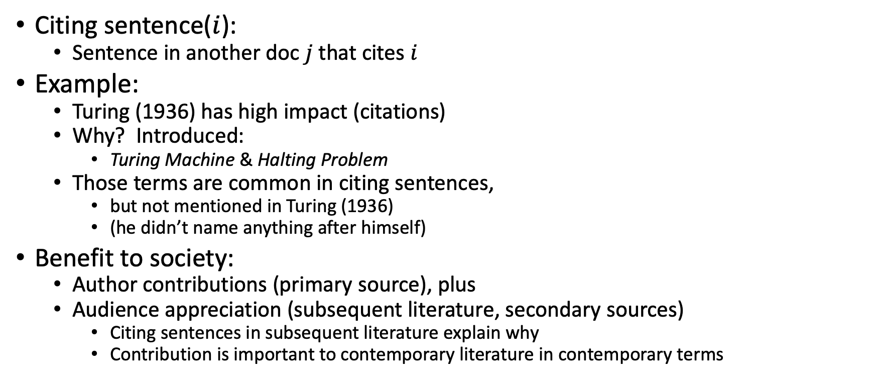
Citing Sentences
Citing sentence($i$):
Sentence in another doc $j$that cites $i$
Example:
Turing (1936) has high impact (citations)
Why? Introduced:
Turing Machine & Halting Problem
Those terms are common in citing sentences,
but not mentioned in Turing (1936)
(he didn’t name anything after himself)
Benefit to society:
Author contributions (primary source), plus
Audience appreciation (subsequent literature, secondary sources)
Citing sentences in subsequent literature explain why
Contribution is important to contemporary literature in contemporary terms
Anchor Text in Web Search

Slide 28



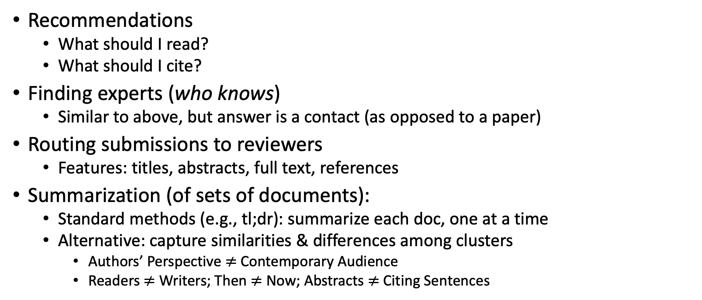
Document Similarities: Use Cases
Recommendations
What should I read?
What should I cite?
Finding experts (who knows)
Similar to above, but answer is a contact (as opposed to a paper)
Routing submissions to reviewers
Features: titles, abstracts, full text, references
Summarization (of sets of documents):
Standard methods (e.g., tl;dr): summarize each doc, one at a time
Alternative: capture similarities & differences among clusters
Authors’ Perspective $≠$Contemporary Audience
Readers $≠$ Writers; Then $≠$ Now; Abstracts $≠$ Citing Sentences

Slide 29
Document Similarities: Use Cases
Recommendations
What should I read?
What should I cite?
Many systems focus on ``relevance’’ (word overlap)
But we also want credibility
Don’t recommend papers that are buzz-word compliant
But not worth reading
(Most papers are never cited)

Slide 30
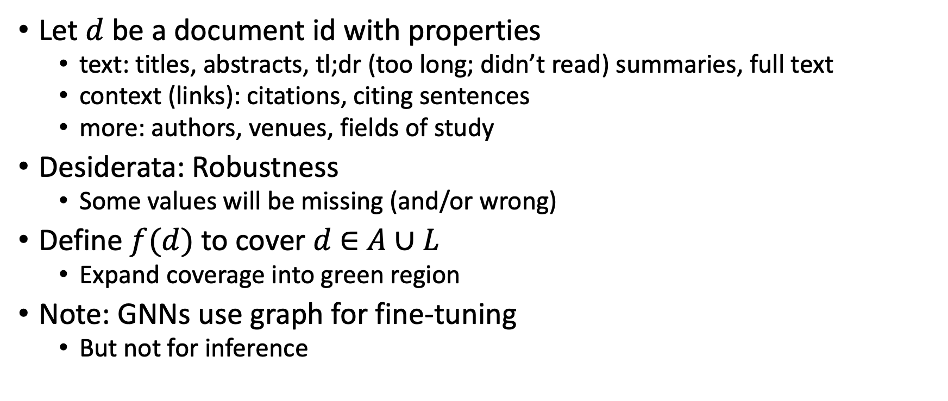
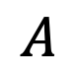
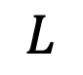
Suggestion for Missing Values
Let $d$ be a document id with properties
text: titles, abstracts, tl;dr (too long; didn’t read) summaries, full text
context (links): citations, citing sentences
more: authors, venues, fields of study
Desiderata: Robustness
Some values will be missing (and/or wrong)
Define $f(d)$ to cover $d$ $∈$ $A∪L$
Expand coverage into green region
Note: GNNs use graph for fine-tuning
But not for inference
$$A$$
$$L$$

Slide 31
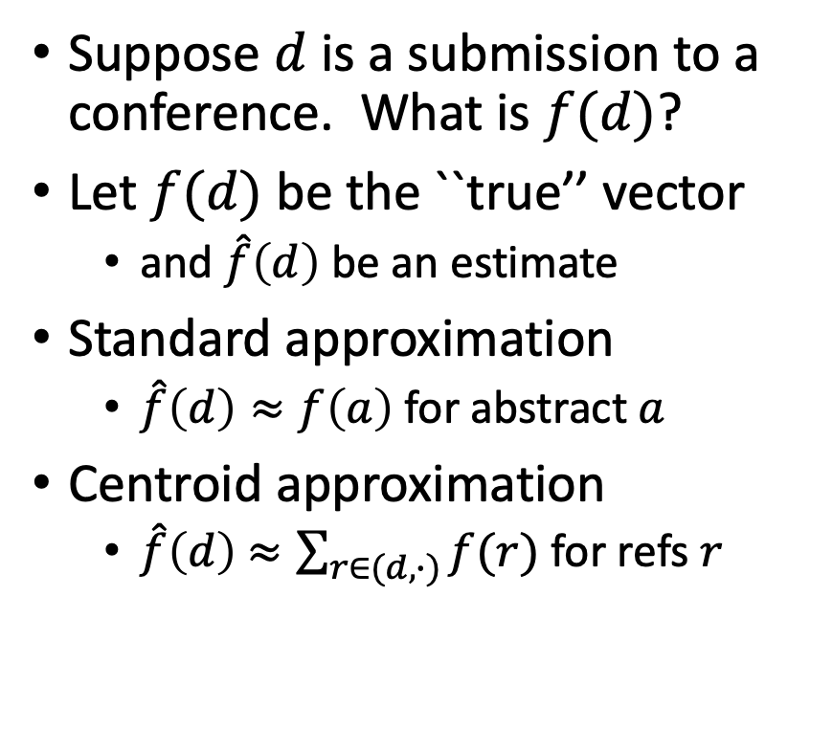
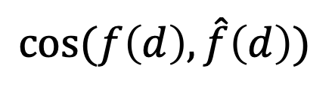
Centroid Assumption
Evidence for Centroid Approximation
Suppose $d$ is a submission to a conference. What is $f(d)$?
Let $f(d)$ be the ``true’’ vector
and $\hat{f}\left(d\right)$ be an estimate
Standard approximation
$\hat{f}\left(d\right)≈f\left(a\right)$ for abstract $a$
Centroid approximation
$\hat{f}\left(d\right)$ $≈\sum_{r∈(d,∙)}{f(r)}$ for refs $r$
$$cos⁡(f\left(d\right), \hat{f}\left(d\right))$$

Slide 32
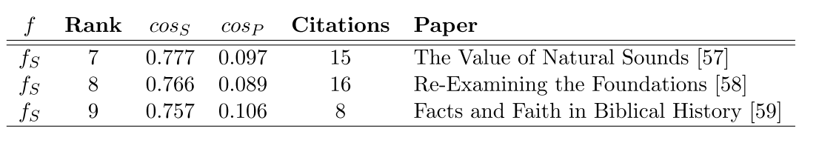
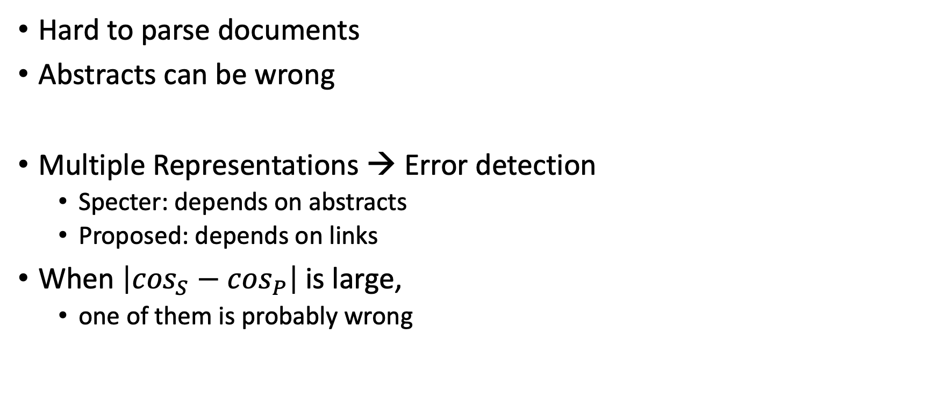
Bad/Misleading Values: Redundancy → Robustness
Hard to parse documents
Abstracts can be wrong
Multiple Representations → Error detection
Specter: depends on abstracts
Proposed: depends on links
When $\left|\cos_{S}−\cos_{P}\right|$is large,
one of them is probably wrong

Slide 33


Rank | Specter | Proposed | Paper
query | 1.000 | 1.000 | 1097: On stress and linguistic rhythm
1 | 0.908 | 0.926 | 0: Linguistic Society of America Structure and Intonation
2 | 0.895 | 0.977 | 475: Preliminaries to linguistic phonetics
3 | 0.885 | 0.921 | 25: Linguistic Society of America On the Definition of Word by
4 | 0.881 | 0.763 | 37: On some defferences between Chinese and Japanese '-Wh'-elements
5 | 0.880 | 0.946 | 2: Some accentuation properties in Japanese and lexical phonology
6 | 0.865 | 0.824 | 6: Two Types of Zi-Verbs in Japanese
7 | 0.777 | 0.097 | 15: The Value of Natural Sounds
8 | 0.766 | 0.089 | 16: Re-Examining the Foundations
9 | 0.757 | 0.106 | 8: Facts and Faith in Biblical History
1 | 0.578 | 0.998 | 226: The phonology of rhythm in English
2 | 0.530 | 0.997 | 74: A grid-based theory of English meter
3 | -1.000 | 0.996 | 5: "What does Phonology tell us about Stress and Rhythm? Some Reflections on the Phonology of Stress"
4 | 0.460 | 0.994 | 1: Syllable structure and stress in Bahdinani Kurdish
5 | 0.442 | 0.994 | 35: Schwa in phonological theory
6 | -1.000 | 0.994 | 163: The Sound Pattern of Russian: A Linguistic and Acoustical Investigation
7 | 0.542 | 0.993 | 27: Empirical evidence for a deletion formulation of the rhythm rule in English
8 | 0.552 | 0.993 | 95: Prosodic Structure Above the Word
9 | 0.334 | 0.993 | 0: Syllable Contraction in Cantonese A-not-A Constructions: An Optimality Account

Slide 34
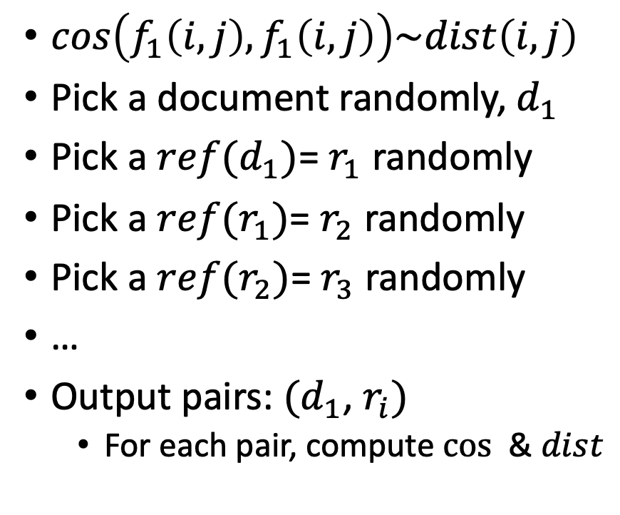
Random Walks
$cos\left(f_{1}\left(i, j\right),f_{1}\left(i, j\right)\right)\sim dist\left(i,j\right)$
Pick a document randomly, $d_{1}$
Pick a $ref(d_{1})$= $r_{1}$ randomly
Pick a $ref(r_{1})$= $r_{2}$ randomly
Pick a $ref(r_{2})$= $r_{3}$ randomly
…
Output pairs: $(d_{1}$, $r_{i})$
For each pair, compute $cos⁡$ & $dist$

Slide 35
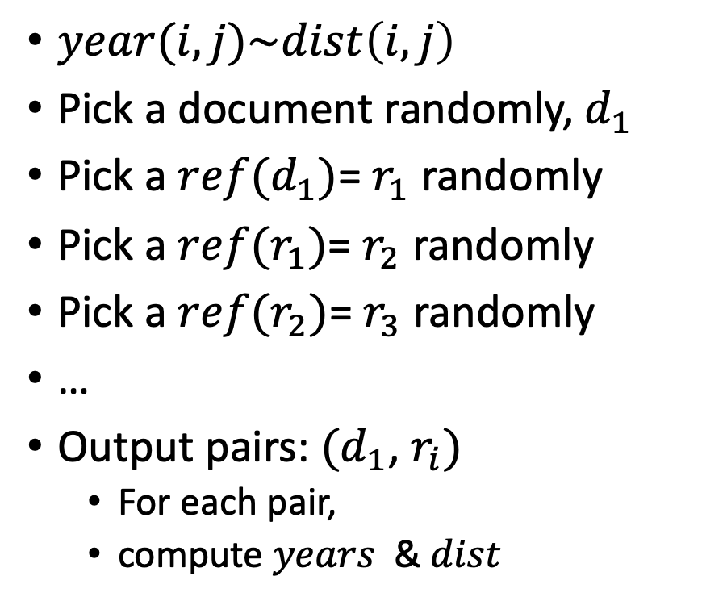
Random Walks
$year(i,j)\sim dist\left(i,j\right)$
Pick a document randomly, $d_{1}$
Pick a $ref(d_{1})$= $r_{1}$ randomly
Pick a $ref(r_{1})$= $r_{2}$ randomly
Pick a $ref(r_{2})$= $r_{3}$ randomly
…
Output pairs: $(d_{1}$, $r_{i})$
For each pair,
compute $years⁡$ & $dist$

Slide 36
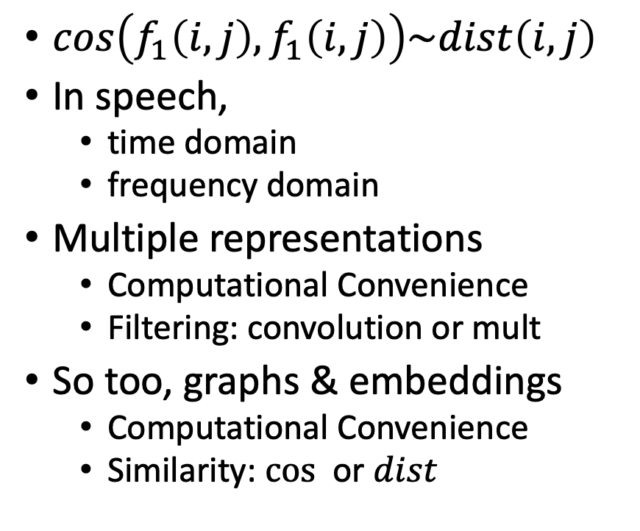
Cos-Dist: Multiple Views of Similarity
$cos\left(f_{1}\left(i, j\right),f_{1}\left(i, j\right)\right)\sim dist\left(i,j\right)$
In speech,
time domain
frequency domain
Multiple representations
Computational Convenience
Filtering: convolution or mult
So too, graphs & embeddings
Computational Convenience
Similarity: $cos⁡$ or $dist$

Slide 37
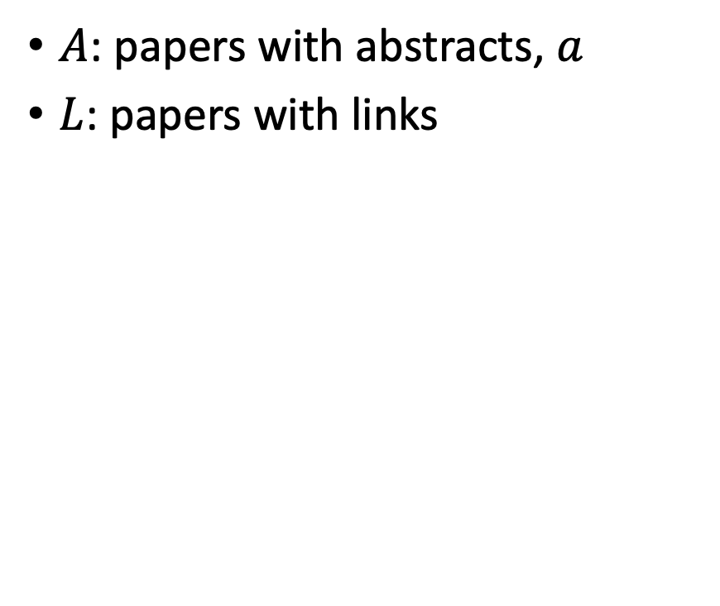
Realities: Missing Values
$A$: papers with abstracts, $a$
$L$: papers with links
Coverage | Pairs (Rand Walk) | Embedding
100% | 3,469,964 | Proposed
78% | 2,707,857 | Specter
35% | 1,216,506 | SciNCL
35% | 1,201,561 | Specter2
Standard Evaluations do not address coverage issues
API provides embeddings (but not abstracts)
for many papers

Slide 38
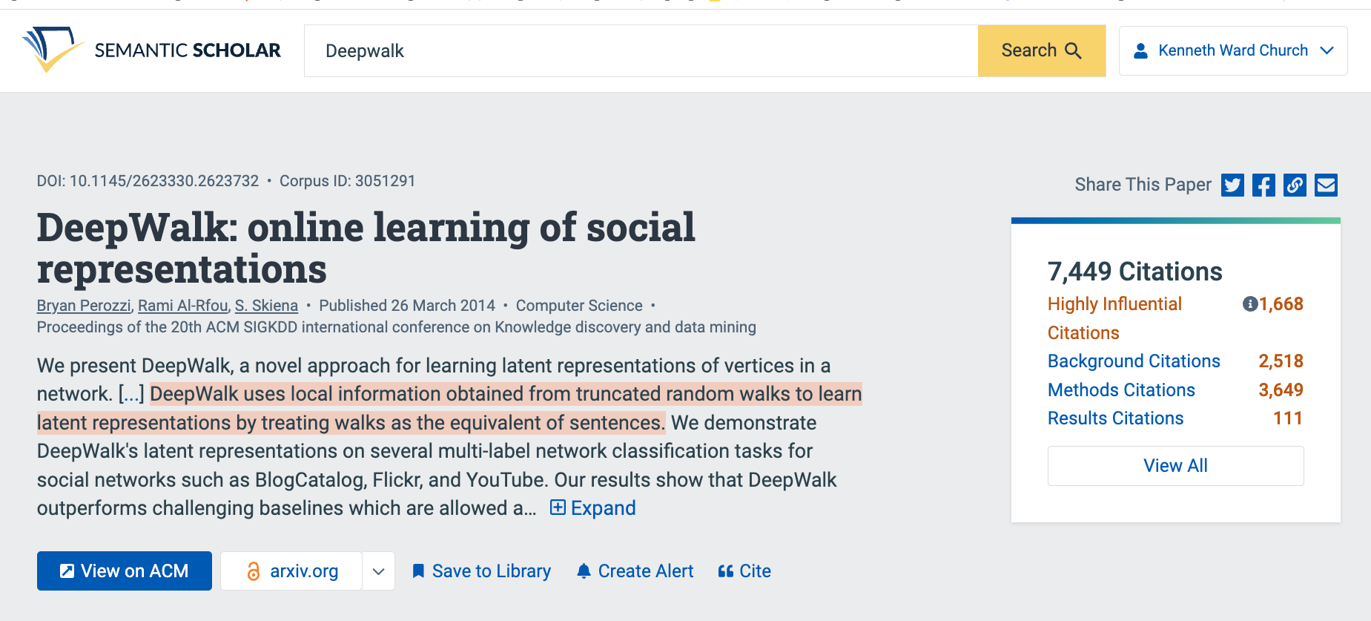
Summaries
Snippets
titles, authors, abstracts
tl;dr (too long; didn’t read)
Author Perspective:
These snippets
Audience Perspective:
Do these snippets capture 7k citations?
Why is this paper important
to contemporary readers?
Citing Sentences

Slide 39
Summarization Baselines
tl;dr
ChatGPT
⚠️ ⚠️ ⚠️ Warning ⚠️ ⚠️ ⚠️
Hallucinations

Slide 40
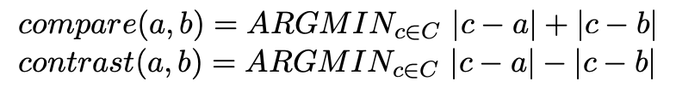
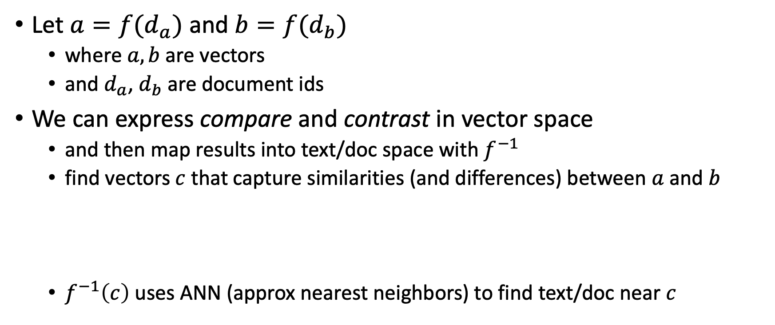
Summarization: Compare & Contrast (Do not summarize each doc, one at a time)
Let $a=f(d_{a})$ and $b=f(d_{b})$
where $a, b$are vectors
and $d_{a}$, $d_{b}$are document ids
We can express compare and contrast in vector space
and then map results into text/doc space with $f^{−1}$
find vectors $c$ that capture similarities (and differences) between $a$ and $b$
$f^{−1}\left(c\right)$ uses ANN (approx nearest neighbors) to find text/doc near $c$

Slide 41
Deliverables https://github.com/kwchurch/JSALT_Better_Together/blob/main/doc/deliverables.md
Better access to literature
Resources:
Many embeddings for many papers
Posted models on HuggingFace
Post code on GitHub
Summarization methods to compare and contrast across small (and large) collections of documents
Support incremental updates to embeddings based on citation graphs
Evaluation:
Better numbers,
as well as better benchmarks
Establish that combinations of text and links are better together (than either by itself)
Establish that citing sentences are useful
Improve methods for assigning papers to reviewers
Theory: Unified framework of
Deep nets and
Linear Algebra
Bibliometrics:
Predict citations of a paper over time.
Predict h-index of an author over time.
Find authors that publish too many papers

